Slide 1
Session 07: Cryptography
MIS 6311-501 Cyber Security Fundamentals
Chris Davis

Slide 2
Housekeeping
Any Questions? Please do not hesitate to email. Or text.
Class Website: https://elearning.utdallas.edu
Dropbox: https://goo.gl/9AFyoE
UTD Email: cmd140430@utdallas.edu
Gmail: davischr2@gmail.com
Google Voice: 214-771-8122 (Text & Emergencies)
LinkedIn: www.LinkedIn.com/in/ChristopherDavis
Blog: www.cloudauditcontrols.com
Class: Monday 7:00pm-9:45pm JSOM 12.210

Slide 3
Academic Calendar & Sessions

Slide 4
Comparison of Our Class to CISSP Domains
Shon Harris Book – Chapters
Current CISSP Domains
2
Information Security Governance and Risk Management
8
Business Continuity and Disaster Recovery Planning
Security and Risk Management
9
Legal, Regulations, Investigations and Compliance
7
Cryptography
Security Engineering
4
Security Architecture and Design
Security Assessment and Testing
5
Physical (Environmental) Security
Asset Security
6
Telecommunications and Network Security
Communications and Network Security
3
Access Control
Identity and Access Management
11
Operations Security
Security Operations
10
Software Development Security
Software Development Security

Slide 5
Tales from the Crypt.
Practical Applications & Lessons Learned.

Slide 6
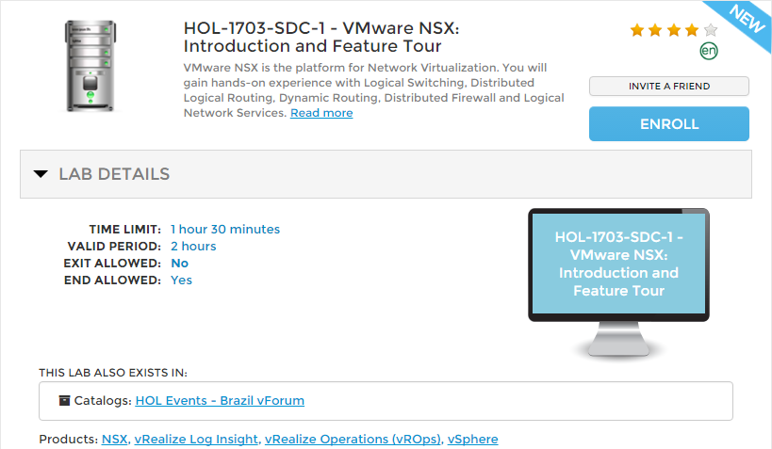
VMware Hands-On Labs (HOL)
http://labs.hol.vmware.com/HOL/

Slide 7
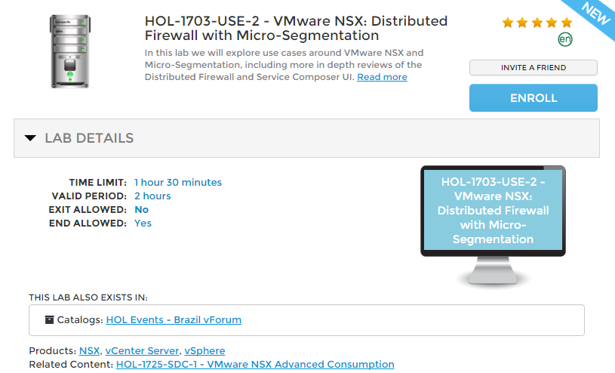

Slide 8
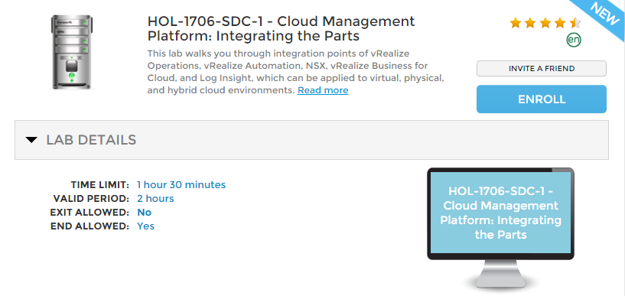

Slide 9
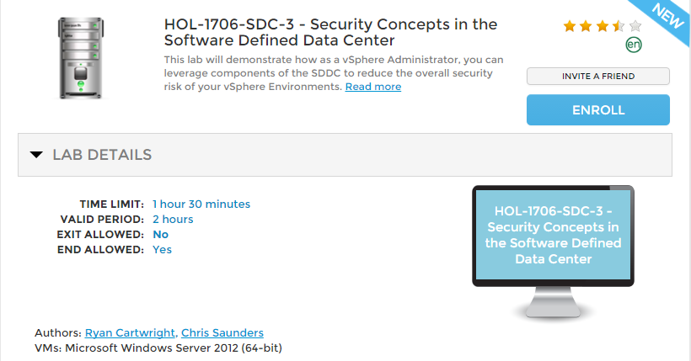

Slide 10
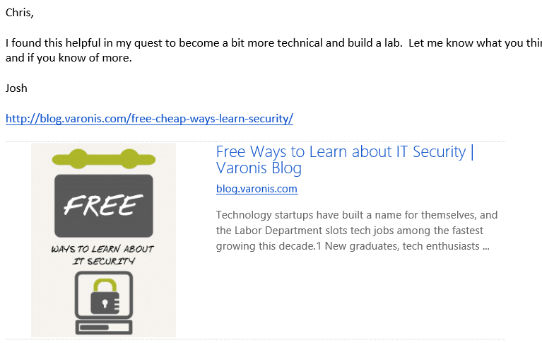

Slide 11

https://www.nsa.gov/ia/_files/factsheets/NSA_Methodology_for_Adversary_Obstruction.pdf

Slide 12
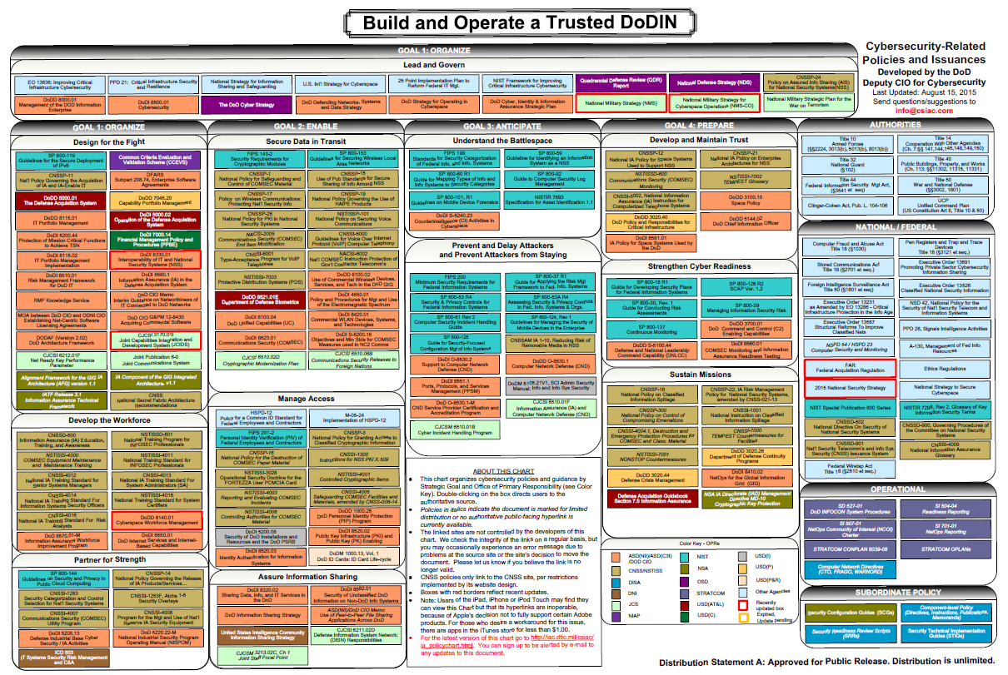
http://iac.dtic.mil/csiac/ia_policychart.html

Slide 13
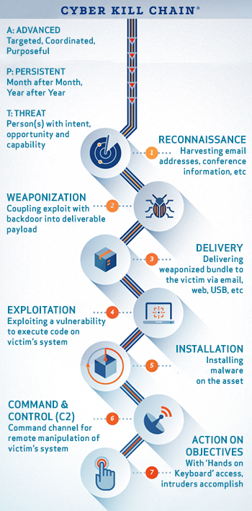
1. Reconnaissance
2. Weaponization
3. Delivery
4. Exploitation
5. Installation
6. Command and Control
7. Actions on Objectives

Slide 14
Intrusion Kill Chain
A kill chain is a systematic process to target and engage an adversary to create desired effects. U.S. military targeting doctrine defines the steps of this process as find, fix, track, target, engage, assess.
Find advisory target suitable for engagement, fix their location, track and observe, target with suitable weapon or asset to create the desired effects, engage advisory, assess effects.
This is an integrated, end-to-end process described as a "chain" because any single deficiency will disrupt the entire process.
Expanding on this concept, Lockheed Martin presents a new kill chain model specifically for intrusions.
The essence of an intrusion is that the aggressor must develop a payload to breach a trusted boundary, establish a presence inside a trusted environment, and from that presence, take actions towards their objectives.
Objectives may include moving laterally inside the environment, or violating the confidentiality, integrity, or availability of a system inside the environment.
The intrusion kill chain is defined as reconnaissance, weaponization, delivery, exploitation, installation, command and control (C2), and actions on objectives.
Notes:
A kill chain is a systematic process to target and engage an adversary to create desired effects. U.S. military targeting doctrine defines the steps of this process as find, fix, track, target, engage, assess. Find advisory target suitable for engagement, fixed their location, track and observe, target with suitable weapon or asset to create the desired effects, engage advisory, assess effects. This is an integrated, into and process described as a "chain" because any single deficiency will disrupt the entire process.
Expanding on this concept, Lockheed Martin presents a new kill chain model specifically for intrusions. The essence of an intrusion is that the aggressor must develop a payload to breach a trusted boundary, establish a presence inside a trusted environment, and from that presence, take actions towards their objectives. Objectives may include moving laterally inside the environment, or violating the confidentiality, integrity, or availability of a system inside the environment. The intrusion kill chain is defined as reconnaissance, weaponization, delivery, exploitation, installation, command and control (C2), and actions on objectives.

Slide 15
Intrusion Kill Chain
1. Reconnaissance - Research, identification and selection of targets, often represented as crawling Internet websites such as conference proceedings and mailing lists for email addresses, social relationships, or information on specific technologies.
2. Weaponization - Coupling a remote access Trojan with an exploit into a deliverable payload, typically by means of an automated tool (weaponizer). Increasingly, client application data files such as Adobe Portable Document Format (PDF) or Microsoft office documents serve as the weaponized deliverable.
3. Delivery - Transmission of the weapon to the targeted environment. The three most prevalent delivery vectors for weaponized payloads by APT actors, as observed by the Lockheed Martin Computer Incident Response Team (LM-CIRT) for the years 2004-2010, are email attachments, websites, and USB removable media.
4. Exploitation - After the weapon is delivered to victim host, exploitation triggers intruders' code. Most often, exploitation targets an application or operating system vulnerability, but it could also more simply exploit the users themselves or leverage an operating system feature that auto-executes code.
Notes:
1. Reconnaissance - Research, identification and selection of targets, often represented as crawling
Internet websites such as conference proceedings and mailing lists for email addresses, social
relationships, or information on specific technologies.
2. Weaponization - Coupling a remote access trojan with an exploit into a deliverable payload,
typically by means of an automated tool (weaponizer). Increasingly, client application data files such
as Adobe Portable Document Format (PDF) or Microsoft office documents serve as the weaponized
deliverable.
3. Delivery - Transmission of the weapon to the targeted environment. The three most prevalent
delivery vectors for weaponized payloads by APT actors, as observed by the Lockheed Martin
Computer Incident Response Team (LM-CIRT) for the years 2004-2010, are email attachments,
websites, and USB removable media.
4. Exploitation - After the weapon is delivered to victim host, exploitation triggers intruders' code.
Most often, exploitation targets an application or operating system vulnerability, but it could also
more simply exploit the users themselves or leverage an operating system feature that auto-executes
code.
5. Installation - Installation of a remote access trojan or backdoor on the victim system allows the
adversary to maintain persistence inside the environment.
6. Command and Control (C2) - Typically, compromised hosts must beacon outbound to an
Internet controller server to establish a C2 channel. APT malware especially requires manual
interaction rather than conduct activity automatically. Once the C2 channel establishes, intruders
have "hands on the keyboard" access inside the target environment.
7. Actions on Objectives - Only now, after progressing through the first six phases, can intruders
take actions to achieve their original objectives. Typically, this objective is data exfiltration which
involves collecting, encrypting and extracting information from the victim environment; violations
of data integrity or availability are potential objectives as well. Alternatively, the intruders may
only desire access to the initial victim box for use as a hop point to compromise additional systems
and move laterally inside the network.

Slide 16
Intrusion Kill Chain
5. Installation - Installation of a remote access trojan or backdoor on the victim system allows the adversary to maintain persistence inside the environment.
6. Command and Control (C2) - Typically, compromised hosts must beacon outbound to an Internet controller server to establish a C2 channel. APT malware especially requires manual interaction rather than conduct activity automatically. Once the C2 channel establishes, intruders have "hands on the keyboard" access inside the target environment.
7. Actions on Objectives - Only now, after progressing through the first six phases, can intruders take actions to achieve their original objectives. Typically, this objective is data exfiltration which involves collecting, encrypting and extracting information from the victim environment; violations of data integrity or availability are potential objectives as well. Alternatively, the intruders may only desire access to the initial victim box for use as a hop point to compromise additional systems and move laterally inside the network.
Notes:
1. Reconnaissance - Research, identification and selection of targets, often represented as crawling
Internet websites such as conference proceedings and mailing lists for email addresses, social
relationships, or information on specic technologies.
2. Weaponization - Coupling a remote access trojan with an exploit into a deliverable payload,
typically by means of an automated tool (weaponizer). Increasingly, client application data files such
as Adobe Portable Document Format (PDF) or Microsoft office documents serve as the weaponized
deliverable.
3. Delivery - Transmission of the weapon to the targeted environment. The three most prevalent
delivery vectors for weaponized payloads by APT actors, as observed by the Lockheed Martin
Computer Incident Response Team (LM-CIRT) for the years 2004-2010, are email attachments,
websites, and USB removable media.
4. Exploitation - After the weapon is delivered to victim host, exploitation triggers intruders' code.
Most often, exploitation targets an application or operating system vulnerability, but it could also
more simply exploit the users themselves or leverage an operating system feature that auto-executes
code.
5. Installation - Installation of a remote access trojan or backdoor on the victim system allows the
adversary to maintain persistence inside the environment.
6. Command and Control (C2) - Typically, compromised hosts must beacon outbound to an
Internet controller server to establish a C2 channel. APT malware especially requires manual
interaction rather than conduct activity automatically. Once the C2 channel establishes, intruders
have "hands on the keyboard" access inside the target environment.
7. Actions on Objectives - Only now, after progressing through the first six phases, can intruders
take actions to achieve their original objectives. Typically, this objective is data exfiltration which
involves collecting, encrypting and extracting information from the victim environment; violations
of data integrity or availability are potential objectives as well. Alternatively, the intruders may
only desire access to the initial victim box for use as a hop point to compromise additional systems
and move laterally inside the network.

Slide 17
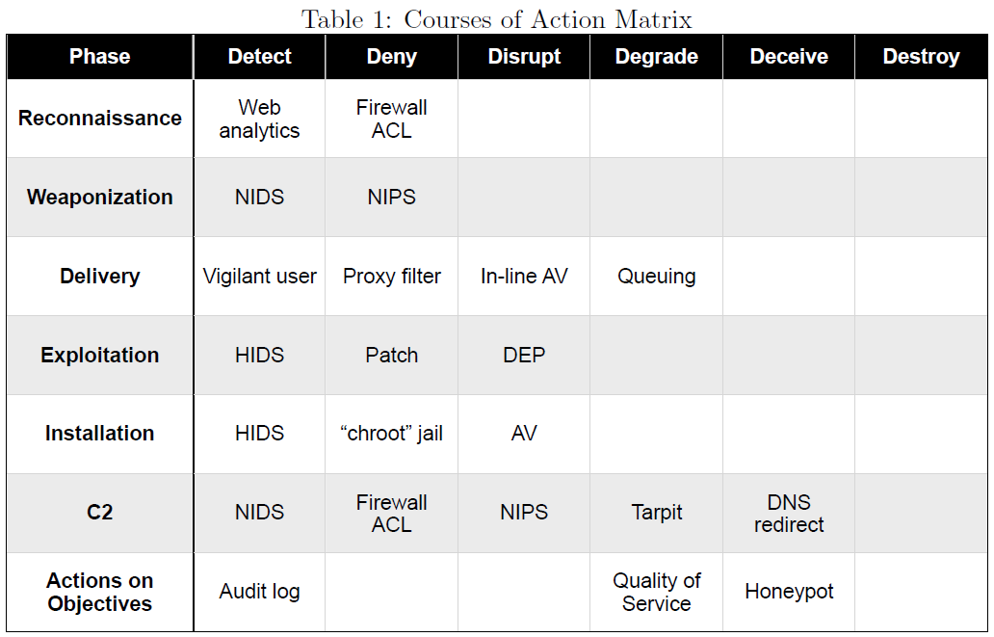
Courses of Action
Notes:
3.3 Courses of Action
The intrusion kill chain becomes a model for actionable intelligence when defenders align enterprise
defensive capabilities to the specic processes an adversary undertakes to target that enterprise. Defenders
can measure the performance as well as the eectiveness of these actions, and plan investment roadmaps
to rectify any capability gaps. Fundamentally, this approach is the essence of intelligence-driven CND:
basing security decisions and measurements on a keen understanding of the adversary.
Table 1 depicts a course of action matrix using the actions of detect, deny, disrupt, degrade, deceive, and
destroy from DoD information operations (IO) doctrine (U.S. Department of Defense, 2006). This matrix
depicts in the exploitation phase, for example, that host intrusion detection systems (HIDS) can passively
detect exploits, patching denies exploitation altogether, and data execution prevention (DEP) can disrupt
the exploit once it initiates. Illustrating the spectrum of capabilities defenders can employ, the matrix
includes traditional systems like network intrusion detection systems (NIDS) and rewall access control
lists (ACL), system hardening best practices like audit logging, but also vigilant users themselves who
can detect suspicious activity.

Slide 18
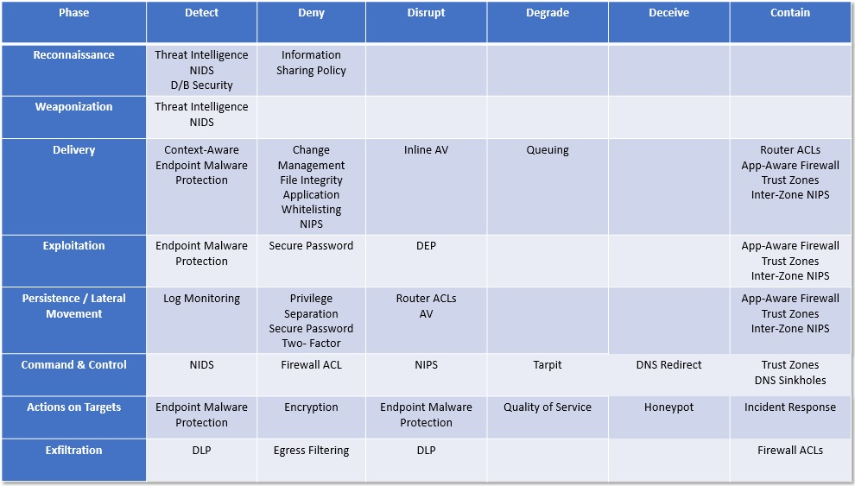
Courses of Action
Notes:
3.3 Courses of Action
The intrusion kill chain becomes a model for actionable intelligence when defenders align enterprise
defensive capabilities to the specic processes an adversary undertakes to target that enterprise. Defenders
can measure the performance as well as the eectiveness of these actions, and plan investment roadmaps
to rectify any capability gaps. Fundamentally, this approach is the essence of intelligence-driven CND:
basing security decisions and measurements on a keen understanding of the adversary.
Table 1 depicts a course of action matrix using the actions of detect, deny, disrupt, degrade, deceive, and
destroy from DoD information operations (IO) doctrine (U.S. Department of Defense, 2006). This matrix
depicts in the exploitation phase, for example, that host intrusion detection systems (HIDS) can passively
detect exploits, patching denies exploitation altogether, and data execution prevention (DEP) can disrupt
the exploit once it initiates. Illustrating the spectrum of capabilities defenders can employ, the matrix
includes traditional systems like network intrusion detection systems (NIDS) and rewall access control
lists (ACL), system hardening best practices like audit logging, but also vigilant users themselves who
can detect suspicious activity.

Slide 19
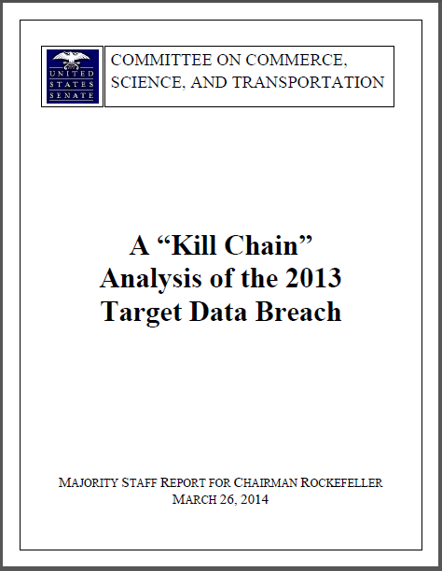
Kill Chain Analysis – Target
http://www.commerce.senate.gov/public/?a=Files.Serve&File_id=24d3c229-4f2f-405d-b8db-a3a67f183883

Slide 20
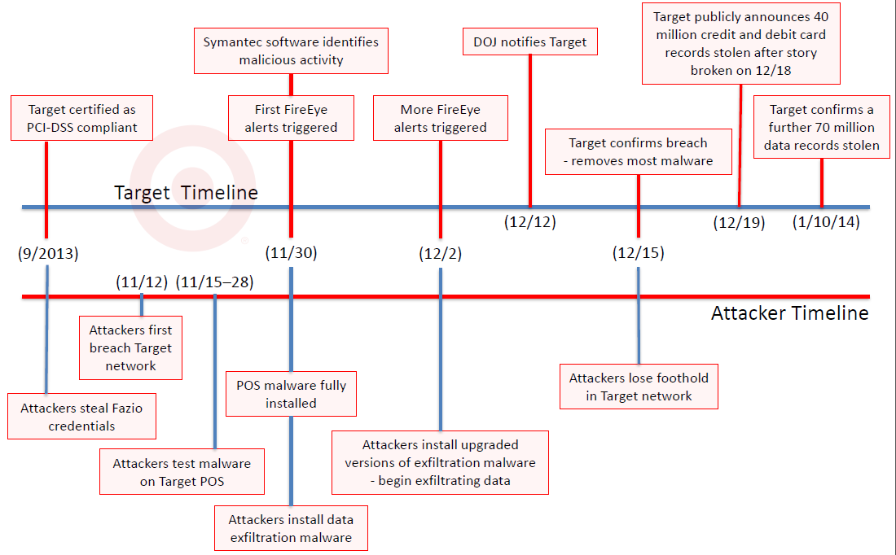
Timeline of the Target Breach

Slide 21
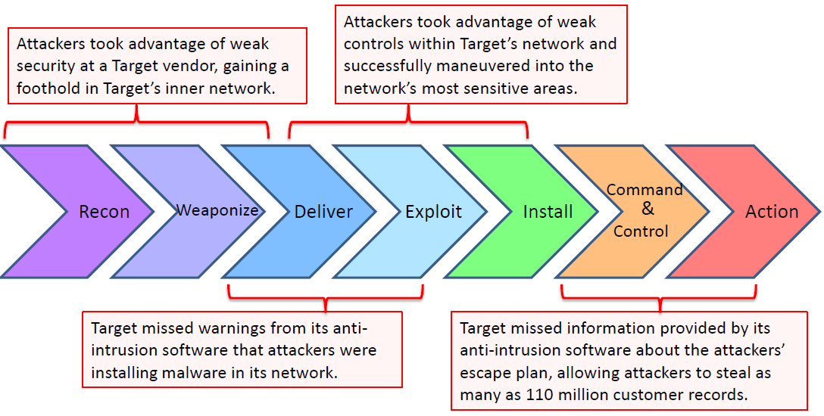
Missed Opportunities

Slide 22
Let’s Get Started.

Slide 23
Session Contents
This chapter presents the following:
Common software development issues • Software development life cycles • Secure software development approaches • Change control and configuration management • Programming language types • Database concepts and security issues • Expert systems and artificial intelligence • Malware types and attacks
Notes:
Security terminology and principles • Protection control types • Security frameworks, models, standards, and best practices • Security enterprise architecture • Risk management • Security documentation • Information classification and protection • Security awareness training • Security governance
Harris, Shon (2012-11-08). CISSP All-in-One Exam Guide, 6th Edition (Kindle Locations 1007-1011). McGraw-Hill Education. Kindle Edition.

Slide 24
Chris's View

Slide 25

Today's Materials
Harris, Shon (2012-11-08).
CISSP All-in-One Exam Guide, 6th Edition.
McGraw-Hill Education.

Slide 26
Chapter xx: crypto

Slide 27
Short Version

Slide 28
Cryptography Fundamentals

Slide 29


Slide 30
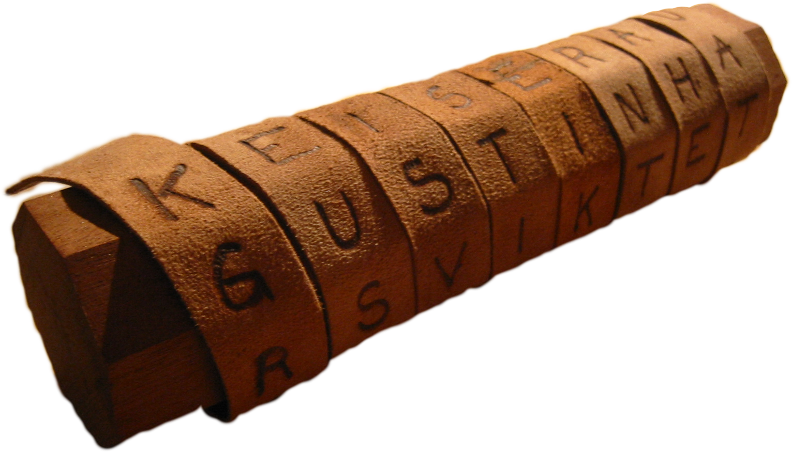
Kryptos Graphein

Slide 31
Overview
The professional should fully understand:
Definitions
History
Cryptography Fundamentals
Symmetric Key Cryptosystem Fundamentals
Asymmetric Key Cryptosystem Fundamentals
Digests
Cryptographic Attacks
Public Key Infrastructure Concepts
Key Distribution and Management Issues

Slide 32
Definitions

Slide 33
Definitions
Plain Text
Cipertext or Cryptogram
Block Cipher
Cipher
Clustering
Codes
Cryptanalysis
Cryptographic Algorithm
Cryptography
Cryptology
Cryptosystem

Slide 34
Definitions
Decipher
Encipher
End-to-End Encryption
Exclusive Or
Key or Crypto variable
Link Encryption
One Time Pad
Steganography
Work Function (or Work Factor)
Brute Force

Slide 35
History

Slide 36
Crypto History
Cryptography—”Secret Writing”
2-3000 B.C. Hieroglyphics
Egyptian scribes uses non-standard hieroglyphics in inscriptions
First known documented example
400 B.C. Spartans – Scytale
Strip of papyrus or parchment wrapped around a wooden rod
Jefferson Disks
Japanese Purple Machine
German Enigma Machine

Slide 37
Cryptography Fundamentals

Slide 38
Locks
Mechanical – use a physical key (Warded lock or tumbler)
Warded lock – old doors, basic padlock, cheap (image)
Tumbler lock – more pieces that a warded lock, key fits into a cylinder which moved the metal pieces such that the bolt can slide into the locked and unlocked position.
Pin tumbler – uses pins
Wafer – uses wafer (not very secure)

Slide 39
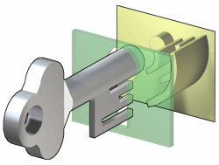
Warded Lock

Slide 40
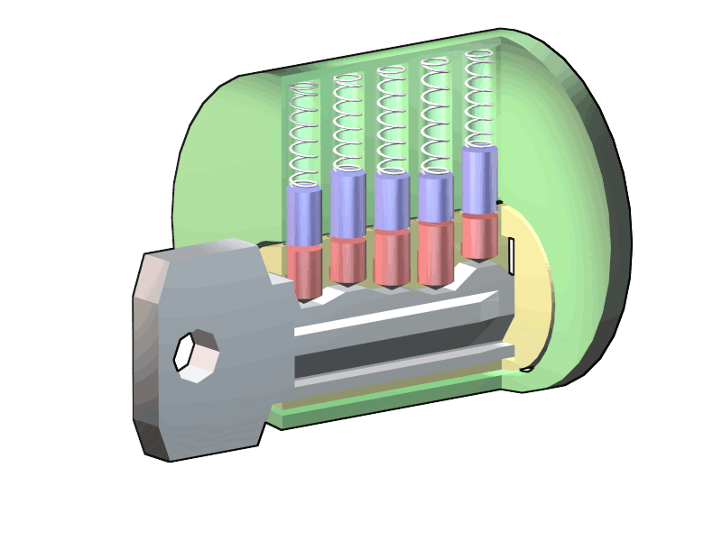
Standard Tumbler Lock

Slide 41
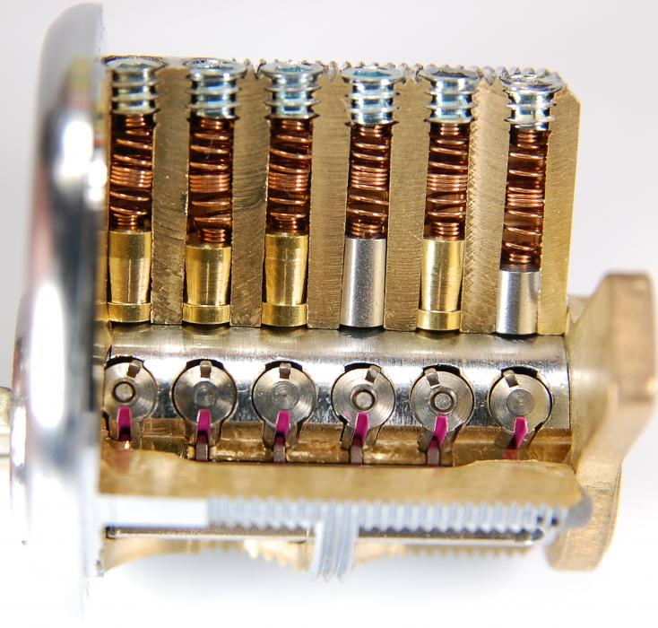
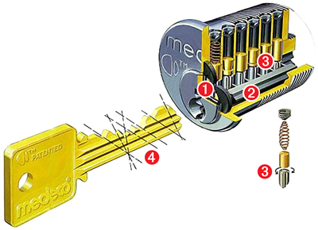
Medco High Security Tumbler

Slide 42
Concept 01: Method and Key
Method
Tumbler mechanism
Physical lock or machine
Algorithm
Key
Combination; physical key
Work factor: amount of time to try all possible combinations or keys before breaking the lock
Algorithms should support many keys

Slide 43
Concept 02: Block and Stream
Block
Fixed chunks are encrypted
Results in the same length output
Example: 64bit chunks of data
You’ll do this exercise later
Stream
Generates a key stream
Combines keystream with plaintext
Usually XOR operation

Slide 44
Crypto Fundamentals
Classical Ciphers
Substitution
Replaces each letter of the plaintext with another that is farther down the alphabet
Caesar “C3” Cipher
Transposition (or “Permutation”)
Keeps but shifts plaintext letters
Can get complicated
Grids: Length and Width
Cracked using frequency analysis
Strengthened when coupled with Substitution and placed in multiple rounds of encoding
Polyalphabetic Cipher
Book or Running Key Cipher
Codes
Steganography

Slide 45

Transposition Example
ACEETKLNTAEPATVM

Slide 46
Cryptographic Attacks: TYPES
The names come from the type of information available to the attacker:
Ciphertext-only: Have cipher text only – attempting to recover plaintext
Known-plaintext: Have cipher and plain text – attempting to recover key
Chosen-plaintext: e.g. have the engine
Adaptive-chosen-plaintext
Chosen-ciphertext: e.g. trial decryption – verify your understanding
Adaptive-chosen-ciphertext:

Slide 47
Cryptographic Attacks: METHODS I
Brute-Force: Exhaustive search
Permutations
Rainbow tables
Symmetric Block Cipher Attacks:
Differential Cryptanalysis
Chosen plaintext attack
Probabilities are assigned to keys
Linear Cryptanalysis
Known plaintext attack
Acts on pairs to create information about the keys
Weak Keys
E.g. DES – 4 keys that are same as encrypt and decrypt
Usually filtered
Algebraic Attacks
Rely on block ciphers having lots of structure
Some special cases encrypting twice with same key doesn’t offer any more security

Slide 48
Cryptographic Attacks: METHODS II
Stream Cipher Attacks
Analyzing the Initialization Vector used in the generation of the key stream
Key stream is used to encrypt data
Man in the Middle
Think “I’ll proxy that handshake for you – thanks!”
HASH Attacks test whether hashes are
One-way functions
Collision free (different sources – same output)

Slide 49
Yeah – It’s Your Birthday
The Birthday Paradox
What’s the size of the group with a 50% probability that:
Someone shares the same birthday as YOU?
Any two people share the same birthday?

Slide 50
Activity: Use Polyalphabetic Cipher to Encrypt This:
Plaintext: THISISFUN
Secret Key: CISSP

Slide 51
Polyalphabetic Cipher Solution

Slide 52

Symmetric Key Cryptosystem Fundamentals
RED
RED

Slide 53
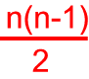
Symmetric Key Cryptography
“Secret Key” or “Shared Key”
This crypto-system uses the same key for both encryption and decryption
Both the sender and the receiver need to have the same key in order to communicate successfully
Formula for number of keys needed for secret communications among users:
‘n’ = # people involved
Examples: DES, 3-DES, RC4, RC5
How it works

Slide 54
Symmetric Key Pros & Cons
Advantages
Very fast relative to public key cryptography;
Considered secure, provided the key is relatively strong
The ciphertext is compact (that is, encryption does not add much excess “baggage” to the ciphertext);
Widely used and very popular.
Disadvantages
The administration of the keys can become extremely complicated;
A large number of keys is needed to communicate securely with a large group of people;
Non-repudiation is not possible (see sidebar for a detailed discussion on nonrepudiation);
The key is subject to interception by hackers.

Slide 55
Symmetric Ciphers
DES
Usually implemented in software:
Electronic Code Block (ECB) (Block cipher)
Cipher Block Chaining (CBC) (Block cipher)
Usually implemented in hardware:
Cipher Feedback Mode (CFB) (Stream cipher)
Output Feedback (OFB) (Stream cipher)
Triple DES – more secure than DES
Rijndael Block Cipher (AES-128, 192 or 256)
Advanced Encryption Standard
Twofish Algorithm
IDEA Cipher
RC5

Slide 56
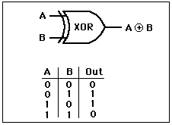
Activity: XOR Encrypt This:
Exclusive OR
Plaintext: 00110101
Secret Key: 11100011

Slide 57
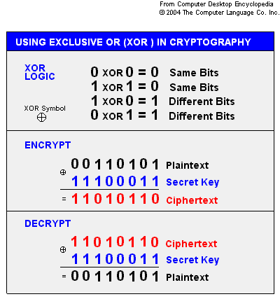
XOR Solution

Slide 58
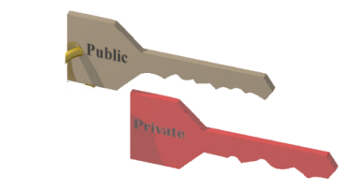
Asymmetric Key Cryptosystem Fundamentals
GREEN
RED

Slide 59
Asymmetric Key Cryptosystems
“Public Key”
This crypto-system uses one key for encryption and another key for decryption
Each user has two keys – one public key, which is revealed to all users, and one private key, which remains a secret. The private key and the public key are mathematically linked;
Encryption is performed with the public key and decryption is performed with the private key;
Examples: RSA, Elliptic Curve Cryptography (ECC).

Slide 60
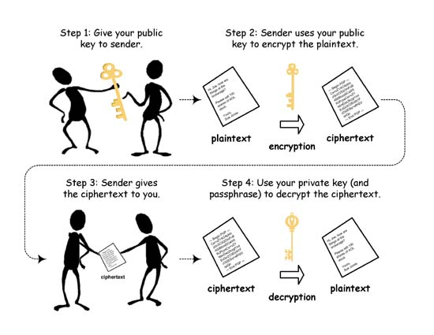
Asymmetric: How it works

Slide 61
Asymmetric Pros & Cons
Advantages:
Considered very secure;
No form of secret sharing is required, thus reducing key administration to a minimum;
Supports non-repudiation, confidentiality, access control, authentication, data integrity (with hash)
The number of keys managed by each user is much less compared to secret key cryptography.
Disadvantages:
Much slower compared to secret key cryptography;
The ciphertext is much larger than the plaintext, relative to secret key cryptography.

Slide 62
Asymmetric Key Algorithms
Diffie-Hellman Key Exchange
Used for KEY EXCHANGE
Also called exponential key agreement
El Gamal
Extension of Diffie-Hellman – approaches RSA such that it allows for message encryption
Works using discrete logs
Merkle Hellman Knapsack
Very complicated math – e.g. “number of objects with given weights from a large set such that the sum of the weights is equal to a pre-specified weight..”
Elliptic Curve (EC)
For the curious: y² + y = x³ * x²

Slide 63
Message Digests

Slide 64
Message Digests
Designed specifically to guarantee message integrity
Message digests achieve data integrity by applying complex math to data to ensure that this data has not been tampered with on route to its final destination.
Message digests take in a variable length input and generate a fixed length output called the “hash” or a message digest
MD5 algorithm generates a 128-bit digest
SHA-1 algorithm generates a 160-bit digest);
It is not computationally feasible to calculate the message based on the digest;
It is not computationally feasible to find two messages which will generate the same digest (this feature is also called “collision resistance”).

Slide 65
Public Key Infrastructure Definitions and Concepts

Slide 66
Public Key Infrastructure
Concepts
Digital Certificates
Certificate Authority
Registration Authorities
Certificate Revocation
Non-repudiation
Time stamping

Slide 67
Discussion: SSL
Putting it all together:
Asymmetric; Symmetric; Hash

Slide 68
Crypto Challenges

Slide 69
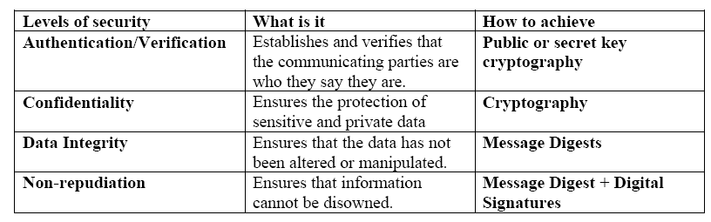
Levels of Security

Slide 70
Key Distribution and Management
Escrowed Encryption
Escrowed Encryption Standard
Key Escrow Approaches Using Public Key Cryptography
Key Management Issues
Symmetric Key:
Where do you store all the private keys?
How do you protect it? With another key?
Asymmetric Key:
Where do you store public keys for easy access?
Where do you store private keys?

Slide 71
Email
Hard to Ensure:
Non-repudiation
Integrity of messages
Authentication of source
Verification of delivery
Message labeling
Industry Solutions:
Secure Multipurpose Internet Mail Extensions (S/MIME)
MIME Object Security Services (MOSS)
Privacy Enhanced Mail (PEM)
Pretty Good Privacy (PGP)

Slide 72
Internet Security Applications
Solutions used commercially:
Message Authentication Code (MAC)
Financial Institution Message Authentication Standard (FIMAS)
Secure Electronic Transaction (SET)
Secure Sockets Layer (SSL) or Transaction Layer Security (TLS)
Internet Open Trading Protocol (IOTP)

Slide 73
Secure Transmissions
IPSec
Authentication Header (AH)
provides authenticity guarantee for packets, by attaching strong crypto checksum to packets
If you receive a packet with AH and the checksum operation was successful, you can be sure the packet was not generated by impersonator and the packet was not modified in transit if: [1] you and the peer share a secret key, and [2] no other party knows the key
Encapsulating Security Payload (ESP)
Provides confidentiality guarantee for packets, by encrypting packets with encryption algorithms.
If you receive a packet with ESP and successfully decrypted it, you can be sure that the packet was not wiretapped in the middle if: [1] you and the peer share a secret key, and [2] no other party knows the key
Integrity
Confidentiality

Slide 74
Kerberos
Used by Microsoft for Active Directory… Variations used by IBM, others

Slide 75
Kerberos - Components
Components
Key Distribution Center – KDC
Authenticating Service – AS
Ticket Granting Service – TGS
Ticket Granting Ticket – TGT
Principles
KDC knows secret keys of all clients and servers
KDC initially exchanges information with client and server using these secret keys
Kerberos authenticates a client to a requested service on a server through TGS and by issuing temporary symmetric session keys for communications between [1] client and KDC, [2] server and KDC, and [3] client and server
Finally, communication starts between client/server using the generated temporary session keys
Variations of Kerberos
SESAME – uses public key crypto to distribute secret keys
KryptoKnight – IBM – Peer-to-peer among parties and KDC

Slide 76
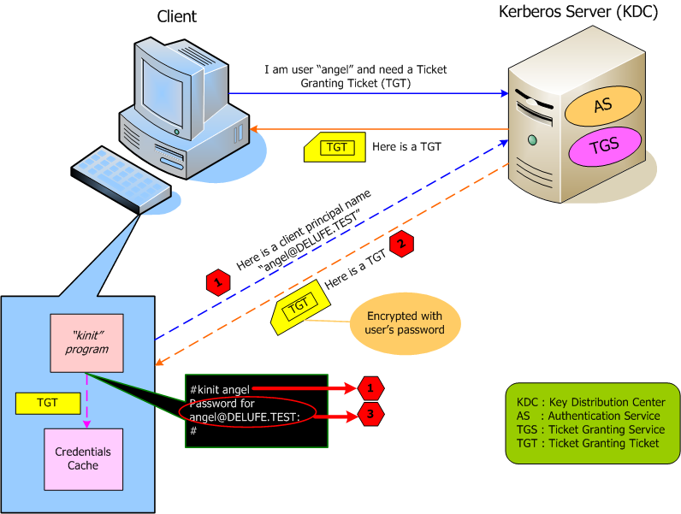
Kerberos – Working Model

Slide 77
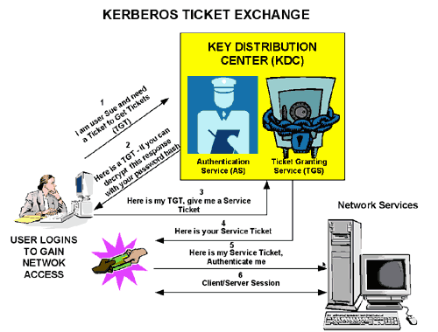
Kerberos – Another Perspective

Slide 78
Thank You
Chris Davis, CISSP, CISA
davischr2@gmail.com

Slide 79
BONUS MATERIALS
Backup Slides

Slide 80
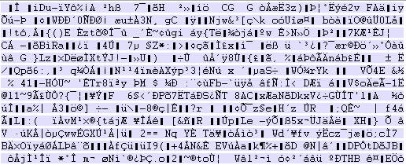
Example of Encrypted Volume
256-Bit BlowFish Encrypted Volume:

Slide 81
Asymmetric Key Algorithms: RSA
Bonus Knowledge:
The RSA algorithm works as follows: take two large primes, p and q, and compute their product n=pq; where n is called the modulus.
Choose a number, e, less than n and relatively prime to (p-1)(q-1), which means e and (p-1)(q-1) have no common factors except 1.
Find another number d such that (ed-1) is divisible by (p-1)(q-1). The values e and d are called public and private exponents, respectively. The public key is the pair (n,e); the private key is (n,d). The factors p and q may be destroyed or kept with the private key.
It is difficult to obtain the private key d from the public key (n, e).
However, if one could factor n into p and q, then one could obtain the private key d.
Thus the security of the RSA system is based on the assumption that factoring is difficult.

Slide 82

Chapter 8: Cryptography
Brian’s Approach

Slide 83
Cryptography (665)
Cryptography – science of encrypting information.
“scrambles” data so only authorized parties can “unscramble” and read data

Slide 84
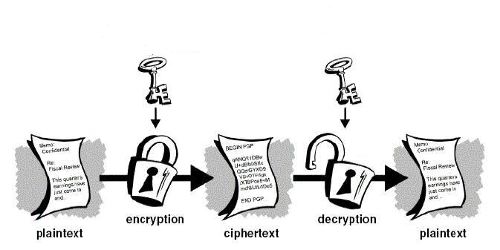
Basic Idea

Slide 85
Cryptography (665)
How do we scramble data?
Substitution (confusion)
Transposition (diffusion)
A strong cipher will use BOTH these methods.

Slide 86
Cryptography (665)
Now it’s time to memorize some terms…

Slide 87
Cryptographic Terminology
Cryptography - a method of storing and transmitting data in a form only intended for authorized parties to read or process.
Cryptanalysis* - science of studying, breaking, and reverse engineering algorithms and keys.

Slide 88
Cryptographic Terminology (671)
Encryption – the method of transforming data (plaintext) into an unreadable format.
Plaintext – the format of data before being encrypted
Cipher text – the “Scrambled” format of data after being encrypted

Slide 89
Cryptographic Terminology (671)
Decryption – the method of turning cipher text back into
Encryption algorithm – a set or rules or procedures that dictates how to encrypt and decrypt data. Also called an encryption cipher
Key (crypto variable) - a values used in the encryption process to encrypt and decrypt

Slide 90
Cryptosystem Definitions (672)
Key space – the range of possible values used to construct keys
example:
Assume a key can be 4 digits long and consist of 0-9
Key space is all combinations from 0000 – 9999
Key space = 10,000
Assume a key can be 6 digits long and consist of 0-9
Key space is all combinations from 0000 – 999,999
Key space = 1,000,000

Slide 91
Cryptosystem Definitions (672)
Key Clustering – Instance when two different keys generate the same cipher text from the same plaintext
Work factor – Estimated time and resources to break a cryptosystem
Ultimate goal is to make the work factor too high for the attacker.

Slide 92
Cryptosystem Development Concepts (674)
Assume the attacker knows your encryption/decryption algorithm.
Algorithms should be open to review.
The only thing that should be secret in a cryptosystem is the “key” (Kerckhoffs Principal)

Slide 93
Key Generation and Management

Slide 94
Key Generation and Management (674)
The goal of designing an encryption method is to make compromising it too expensive to be worth it*.
The amount of work to break it is called “work-factor”*
Protecting the key is important. There is no point to designing an encryption system that would take 1,000,000 years to break if you can easily just get someones key!
Key Protection is CRITICAL*
(more)

Slide 95
Key Generation and Management
The larger the key space is, the more secure a cryptosystem is, this is called “Key Complexity”
Keys should be extremely random and use the full spectrum of the key space
Example:
Assume your key can be 10 digits
Is 0000000001 a good key?
(more)

Slide 96
Key Generation and Management
Keys must be securely distributed and stored
Keys lifetime should correspond with the sensitivity of the data to be protected, and the amount of times the key is used.
If a key is used often, it should be retired after a certain lifetime.
Keys should be destroyed when their lifetime is at and end.
Keys should be backed up in case of emergency

Slide 97
Cryptography History

Slide 98
Cryptography History (667)
Romans used a shift cipher called a “CEASAR” cipher. Shift Ciphers simply shift characters in an alphabet.
(visual on next slide)

Slide 99
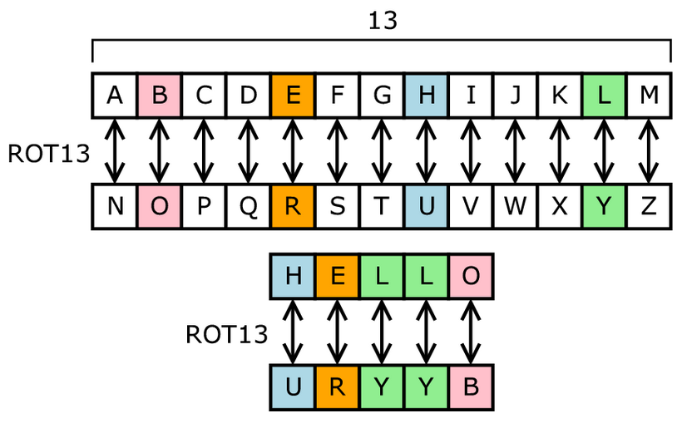
ROT 13

Slide 100
ROT 13
Go to http://www.rot13.com to try

Slide 101
Transposition Cipher
Jumbles up the ordering of characters in a message. The Spartans of Greece used a form of this called the “Scytale” Cipher.

Slide 102
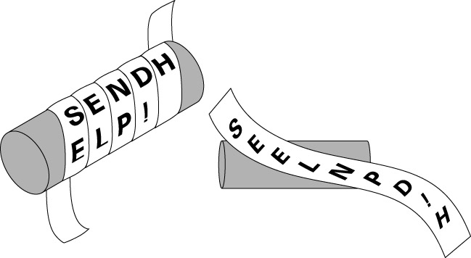
Scytale (667)

Slide 103
Vigenere Cipher (669)
Polyalphabetic Substitution Cipher – A more advanced substitution cipher as it any letter can have multiple letters substituted for it!
That is an A will not always map to an N
Harder to break!
Visual next slide

Slide 104

Vigenere Cipher

Slide 105
Symmetric Encryption

Slide 106
Symmetric Encryption (686)
Idea same key is used to BOTH encrypt and decrypt data!

Slide 107
Symmetric Encryption (686)
Called Symmetric or Private Key encryption
Anyone with the key can either encrypt or decrypt
Must securely distribute keys to both parties.
Chicken in the egg situation with networks
Very Fast to encrypt or decrypt
Key Management is the big issue

Slide 108

Key Management (687)
n: number of parties who want to securely communicate
# keys = (n*(n-1)) / 2
5 = (5*4)/2 = 10 keys
10 = (10*9)/2 = 45 keys
100 = (100*99)/2 = 4950 keys
1000 = (1000*999)/2 = 499500 keys

Slide 109
Encryption Modes

Slide 110
Encryption Modes – Block (692)
Take the message and break it up into fixed sized blocks, encrypt each block using the given key.
Visual next page

Slide 111

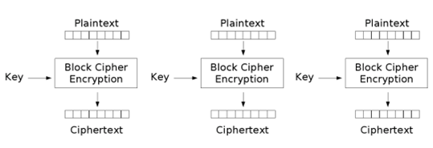
Block (692)

Slide 112
Block Encryption (692)
Problems with Block Encryption?
If a block has the same contents, the resulting cipher text block will have the same cipher text. (Example next slide)

Slide 113
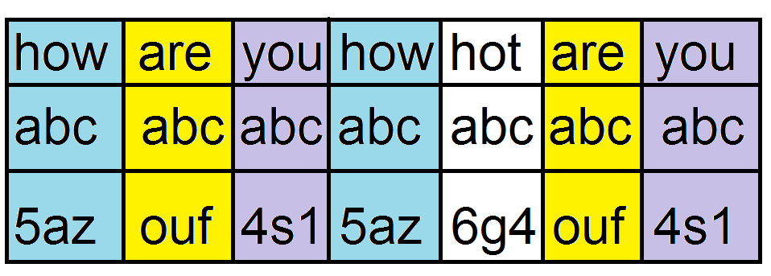
Block encryption problem

Slide 114
Block Encryption Problems (695)
Often with block encryption, we include a value in addition to the key that changes for each block, so we don’t get repetitive cipher text blocks.
CBC chaining & Initialization Vectors

Slide 115
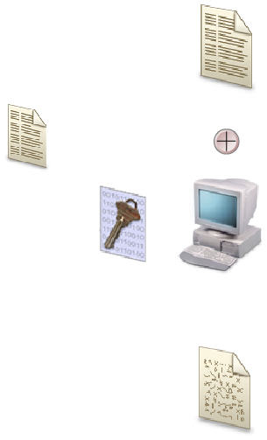
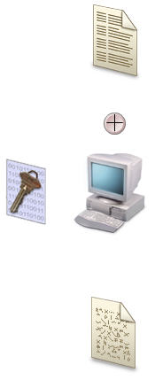
Cipher Block Chaining (706)
Replaces IV
IV

Slide 116
Counter Mode (709)
Sometimes you want to do cipher block chaining but the data is not processed serially.
Use an increasing counter as the extra encryption information.

Slide 117
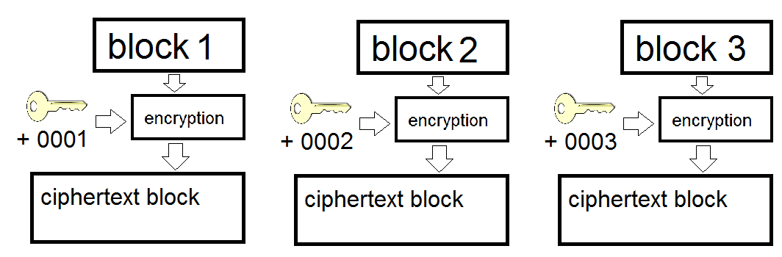
Counter Mode (709)

Slide 118
Stream Encryption

Slide 119
XOR (n/b)
XOR is a Boolean mathematical function which creates an output bit based on two input bits. It outputs a 1 IF and ONLY if one bit of input is 1 and the other is a 0.
INPUT1 INPUT 2 XOR OUTPUT
-------------------------------------------------------------------
0 0 = 0
0 1 = 1
1 0 = 1
1 1 = 0

Slide 120
Stream Encryption (695)
The key is used with a key stream generator which creates a series of bits each are mathematically combined with the bit stream of plaintext to produce cipher text.
Used when data is not available in large blocks
Keyboard input
Morse code
Any input that arrives one bit or byte at a time
(visual next slide)

Slide 121
Stream Encryption
Plain Text Bit Keystream Bit Output Bit
0 1
1 1
1 0
0 1
1 XOR 1 = 0
Cipher text = 0

Slide 122
Stream Encryption
Plain Text Bit Keystream Bit Output Bit
0 1
1 1
1 0
0 XOR 1 = 1
Cipher text = 0 1

Slide 123
Stream Encryption
Plain Text Bit Keystream Bit Output Bit
0 1
1 1
1 XOR 0 = 1
Cipher text = 0 1 1

Slide 124
Stream Encryption
Plain Text Bit Keystream Bit Output Bit
0 1
1 XOR 1 = 0
Cipher text = 0 1 1 0

Slide 125
Stream Encryption
Plain Text Bit Keystream Bit Output Bit
0 XOR 1 = 1
Cipher text = 0 1 1 0 1

Slide 126
Stream Cipher considerations
Stream ciphers are hard work, better done in hardware*
The key stream generator should :
Produce a key stream with a balanced number of equivalent number of 0’s and 1’s
Not generate repeating patterns.
Not product predictable output
Not produce a key stream related to the key

Slide 127
Cipher Feedback Mode (707)
Similar to Cipher Block Chaining in block mode, however in this case, we are using a stream cipher. We will use 1 few bits of the cipher text to modify the output of a key stream generator.
Think “Cipher Block Chaining” for stream encryption.

Slide 128
One Time Pad (677)
A perfect cryptosystem that works as follows.
each party has a book (pad) of symmetric keys, each key is as at least as long as the message to be encrypted.
A message is encrypted with the first key, then that key is discarded.
The message is sent.
The message is decrypted on the other side with the recipients matching first key, then that key is also discarded.
After each time a message is encrypted/decrypted the key is destroyed and never used again.

Slide 129
One Time Pad considerations
For a One Time Pad to truly be perfect the following conditions must be met.
The pad must be shared by both sides*
The pad must be used only one time*
The pad must be as long as the message*
The pad must be securely distributed*
The pad must be created from truly random values*

Slide 130
One Time Pad (677)
1011 – plain text
0101 – pad
------ XOR
1110 – cipher text

Slide 131
Symmetric Algorithms

Slide 132
Symmetric Algorithms – DES (703)
Data Encryption Standard
Developed from at NIST request for an encryption standard
Chosen algorithm was called “Lucifer” from IBM
Block Cipher
Fixed sized blocks of 64 bits
Key size 64 bits, effective size is 56 bits
16 rounds of substitution and transposition
DES is no longer considered strong enough, can be broken easily with distributed computing.

Slide 133
Triple DES (710)
Nothing but DES 3 times
3DES – EEE3
3DES – EDE3
3DES – EEE2
3DES – EDE2
Since it’s 3 x DES, 48 rounds of substitution and transposition.

Slide 134
AES (711)
Developed as a replacement to DES
Actual algorithm is called “Rinjdael”
Block cipher
128 bit blocks
Key sizes of 128,192, 256
Rounds depend on key size
9: for 128 keys
11: for 192 keys
13: for 256 bit keys

Slide 135
RC5 (712)
Block cipher
Block size 32, 64, 128
Key Size up to 2048 bits
Rounds up to 255, minimum of 12 recommended

Slide 136
RC6 (712)
Block cipher based on RC5, same attributes as RC5
Developed to be a AES candidate
Faster that RC5

Slide 137
RC4 (712)
Stream cipher – what was that again?
Was proprietary, but released on Internet in 1994, “ARC4” is the “open version of RC4”
Key length 8 – 2048 bits
Used in SSL and WEP communication

Slide 138
Blowfish (712)
Block cipher
64 bit blocks
Key size 1 - 448 bits
16 rounds of substitution and transposition
Created by Bruce Schneier for anyone to use freely
"Blowfish is unpatented, and will remain so in all countries. The algorithm is hereby placed in the public domain, and can be freely used by anyone."

Slide 139
IDEA (711)
International Data Encryption Algorithm
Proposed AES candidate
Block cipher
64 bit blocks
128 bit keys
Used in PGP

Slide 140
Symmetric Review

Slide 141
Symmetric Pros
Encryption is fast

Slide 142
Symmetric Cons (688)
Keys must be security distributed
How do you get a key securely across an insecure channel?
Key management becomes difficult as the number of nodes increases.
Does Not provide Authenticity or Non-repudiation

Slide 143
Symmetric (688)
For the exam:
Understand the concept
Understand it’s strengths
Understand it’s weaknesses
Understand the different algorithm properties highlighted on the slides.

Slide 144
Asymmetric Encryption

Slide 145
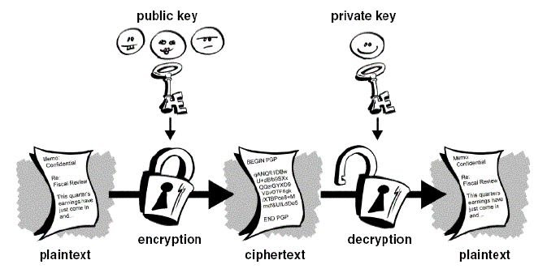
Asymmetric Encryption (688)
Use 2 keys, public key to encrypt a message, private key can decrypt
!=

Slide 146
Asymmetric Encryption (688)
Also called public key encryption
Requires 2 related keys
Public key – given to anyone
Private key – kept secret
Public key is used to encrypt message
Private key is used to decrypt message
Private key is used to sign messages
Public key is used to validate signed messages

Slide 147
Asymmetric Properties
Key exchange is simple!
Asymmetric encryption is SLOW
Asymmetric is not used for bulk encryption
Asymmetric Encryption uses “trapdoor” functions to make hard work easier. (just memorize this)
Can be used to “digitally sign” a message
Provides integrity
Provides non-repudiation

Slide 148
Diffie-Hellman (713)
The original Asymmetric algorithm
Developed to address shortfalls of key distribution in symmetric key distribution.*
Enables two people to receive a symmetric key securely without a previous relationship*
Generates session keys for secure SYMETRIC encryption communications*
Algorithm is based on “difficulty of calculating discrete logarithms in a finite field”*
Vulnerable to “man in the middle” attacks*

Slide 149
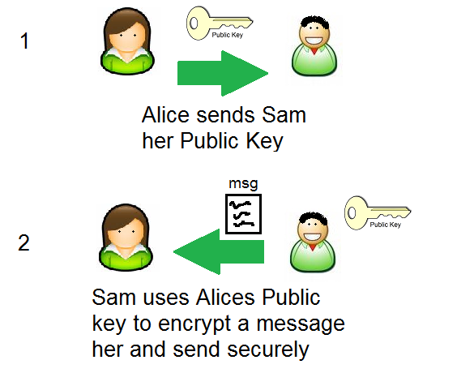
Using Asymmetric Encryption for Key Exchange

Slide 150
Asymmetric Algorithms – RSA (716)
Can be used for digital signatures, key exchanges*, and encryption
Security based on difficulty of factoring large numbers.
Private and Public keys are functions of large prime numbers.
Was patented, has expired

Slide 151
Asymmetric Algorithms – DSA
Designed for use in the Digital Signature Standard (DSS).
Can only be used for signing.

Slide 152
El-Gamal (719)
Encryption, key exchanges or digital signatures
Actually an extension of Diffie-Hellman
Security based on computing discrete logarithms in a finite field
Slowest of all methods we will discuss

Slide 153
Elliptic Curve Cryptosystem (719)
Used for digital signatures, encryption and key distribution
The fastest asymmetric algorithm that we discuss*
Deals with discrete logarithms of elliptic curve*.
Because it’s fast and does not require a lot of resources it is used on devices with limited resources*

Slide 154
Asymmetric Overview
Uses 2 keys, one for encryption, one for decryption
This mitigates the key management, key distribution problem (kind of…)
Can provide integrity and proof of sender (non-repudiation)
Is VERY slow
Often used in a hybrid system
Encrypt symmetric keys using asymmetric algorithms
Do large scale encryption with these asymmetric keys!

Slide 155
Hashing (721)
Hey… didn’t I already tell you to get your mind out of the gutter? …

Slide 156
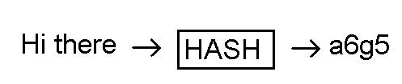
Hashing (721)
Hashing is similar to encryption… but different.
Hashing is a one way operation.
Take input message of any length
Put through hashing function
Retrieve fixed length output (hash digest)

Slide 157
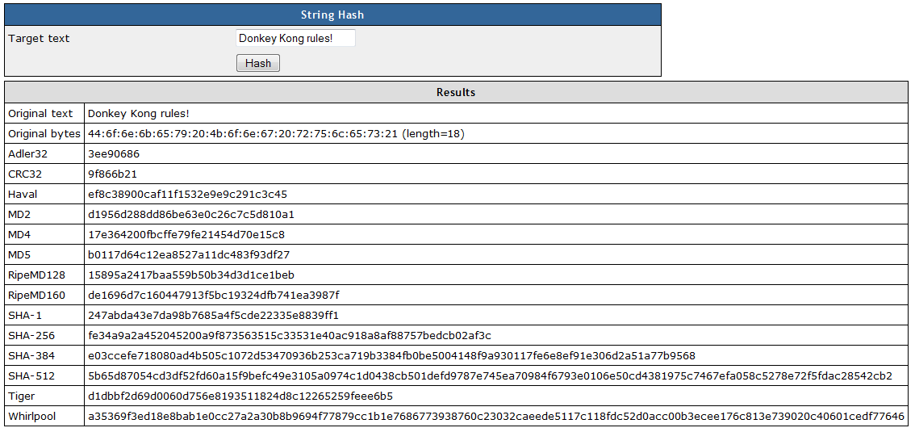
Hash
Try for yourself at http://www.fileformat.info/tool/hash.htm

Slide 158
Hashes (721)
Hashing is a one way operation. Once hashed, no way to get back the original message
Hash digests are fixed, so multiple messages could produce the same hash digest (collision) oh… no...

Slide 159
Hashes (721)
Hashing can provide integrity against non-intentional modifications.
Hashes can be combined with a private key to provide protection against intentional modification.
Generally, the more bits in the digest the more secure, all other things being equal

Slide 160
Hash algorithms – SHA (727)
Secure Hash Algorithm
Designed/Published by NIST
Designed for use in the DSS
Modeled after MD4
SHA-0 (retired)
SHA-1 (SHA-160) – 160 bit digest
512 bit blocks
SHA-256 – 256 bit digest
512 bit blocks
SHA-384 – 384 bit digest
1024 bit blocks
SHA-512 – 512 bit digest
1024 bit blocks

Slide 161
MD2 (727)
Developed by Ronald Rivest (of RC and RSA fame)
Optimized for 8 bit computers
128 bit digest
128 bit blocks

Slide 162
MD4 (727)
Optimized for 32 bit computers
128 bit digest
Used as the hash algorithm for Windows NTLM password hashes

Slide 163
MD5 (727)
Similar to MD4, but more secure
Slower
128 bit digest
512 bit blocks
Moving away from, to SHA

Slide 164
Attacks against Hashes (729)
Collisions – figure out how to create a message with the same hash value (collision)
Ex. “I’d like to buy 100 units of the widget” => A3BT
What if I could make the messages “I’d like to buy 500 units of the widget” and have the same hash value “A3BT” I can beat the integrity constraint
This is called a birthday attack

Slide 165
Hash overview
Know what a hash is
Concept
Fixed length digest
What is a hash used for
Know what a collision is
Know it’s susceptible to MiM
Know what HMAC is, and what it tries to accomplish

Slide 166
Hash Overview
Understand a good hash function should not make it predictable on how to “force” a collision
Be familiar with MDx, and SHA-x
Understand that SHA is considered the best algorithm

Slide 167
HMAC (722)
HMAC – uses a secret hey in combination to a hash algorithm to verify that a hash is not tampered with.
Rather than just computing the hash digest of the message. Compute the hash digest of the message + a shared secret key.
The hash digest is called a MAC (Message Authenticating Code)

Slide 168
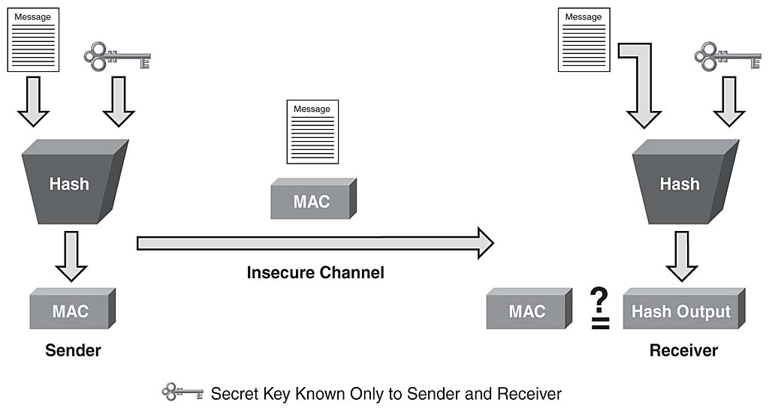
HMAC (722)

Slide 169
HMAC (722)
Provide integrity and data origin authentication
Does not provide confidentiality
Does not provide specific originator authentication

Slide 170
Validating a Messages Integrity

Slide 171
CBC-MAC (724)
Message is encrypted with a symmetric block cipher the final block of cipher text is used as the MAC.
Sender sends the plaintext and the MAC.
Does not use a HASH
Provides authentication and integrity
Does not provide confidentiality

Slide 172
Non-Repudiation (675)
Non-Repudiation – being able to definitively prove someone said or wrote something.
Proves they actually sent a message
Proves the message was not altered

Slide 173
Non-Repudiation (675)
How can we provide non-repudiation?

Slide 174
Digital Signatures (730)
We can use Asymmetric Cryptography and Hashes. To provide
Message authenticity
Integrity
Non-repudiation

Slide 175
Digital Signing (730)
To digitally sign something.
Run message through hash algorithm to generate a message digest
Encrypt the message digest with your private key
Send both the original message and the encrypted message digest

Slide 176
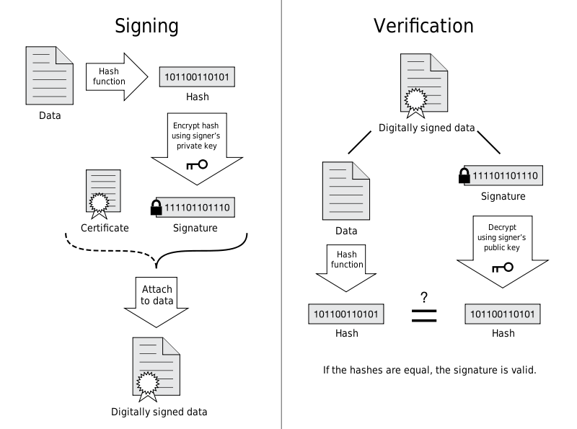
Digital Signature

Slide 177
Digital Signing (730)
If a user can decrypt the encrypted hash it proves:
You sent the message
The message has not been altered

Slide 178
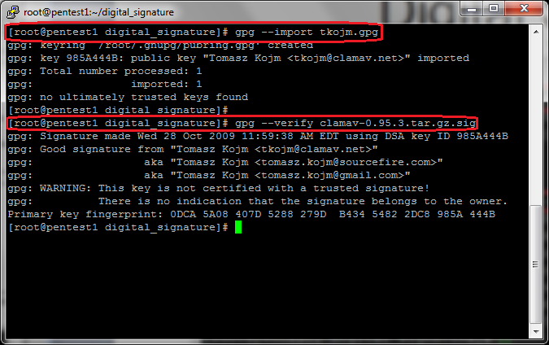
Digital Signing

Slide 179
Services Cryptosystems Provide
Cryptosystems provide the following services
Confidentiality
Integrity
Authentication
Authorization – upon authentication, a user can be provided with a password to access a resource
Non repudiation

Slide 180
Attacks Against Cryptology

Slide 181
Cipher Text Only Attacks (761)
An attacker collects lots of cipher text messages that have been encrypted with the SAME key
Use statistical analysis to attempt to determine the encryption key

Slide 182
Known-Plaintext Attack (761)
An attacker has some plaintext and the corresponding cipher text of a messages
Use statistical analysis to try to obtain the key
Example
in WWII Japanese and German transmissions always started with a certain phase. The “Allies” knew the starting phrase and they could record the encrypted messages so they were able to eventually determine the key.

Slide 183
Chosen-Plaintext Attack (761)
Same as known plaintext, however the attacker can chose which plaintext he has access to.

Slide 184
Chosen Cipher text Attack (762)
An attacker can choose some portion of the message to be decrypted and receive the corresponding plaintext.
Goal is to figure out the key
This is much less likely a scenario.

Slide 185
Non-Encryption Ciphers

Slide 186
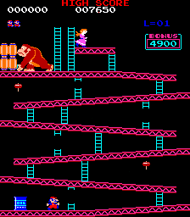
Stenography

Slide 187
Steganography
Donkey Kong is cool!
Don’t believe me?
Go to http://www.paladingrp.com/splus/dk.png
Save that file
Go to http://www.imagecipher.com
Upload the file, and decrypt

Slide 188
Steganography (680)
Attempts to send a message “in plain sight”, by hiding it in another message (a picture)
What is a picture as far as a computer is concerned?
How does this work?

Slide 189
Other Non-Encryption Ciphers (679)
Running Cipher – does not use encryption.
Example.
Find a certain book, turn to a certain page, then pick the letter from word 50 character 5.. An on and on to build a message.
Concealment Cipher – a message within a message. Similar to running cipher but delivered in a single message.

Slide 190
PKI

Slide 191
Public Key Infrastructure (733)
Symmetric key encryption is fast , but has what MAJOR problem?
Secure key distribution
No way to provide non-repudiation

Slide 192
Public Key Infrastructure (733)
Asymmetric Key encryption can be combined with Symmetric Key encryption to solve both problems.

Slide 193
Using Asymmetric Encryption for Key Exchange

Slide 194
Public Key Infrastructure (733)
But…

Slide 195
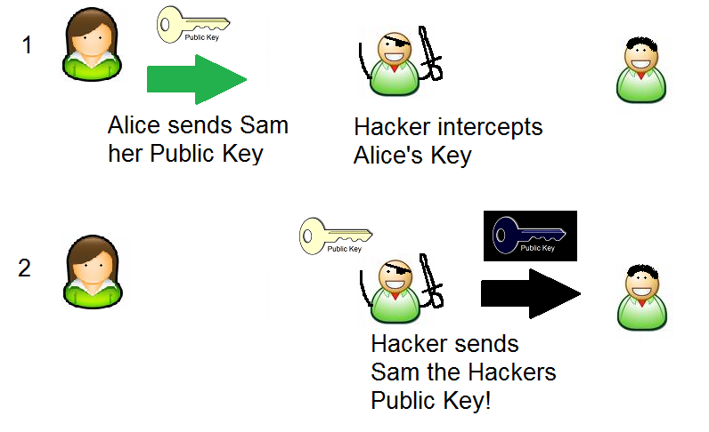

Slide 196
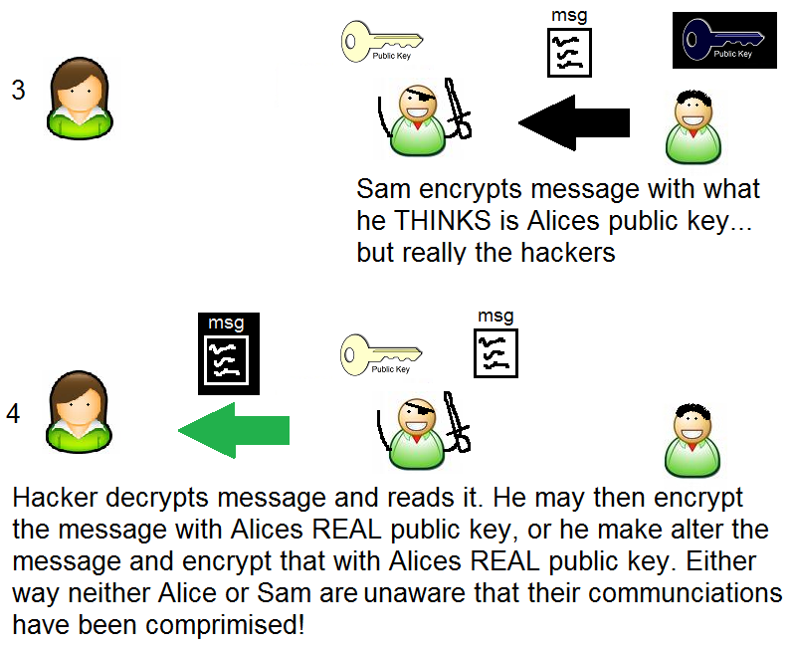

Slide 197
Public Key Infrastructure
Wouldn’t it be nice if some one we could distribute public keys AND be assured that the public key we received was the actual public key of the person we expect to talk to?

Slide 198
PKI
PKIs are generally concerned with ensuring and managing identity trust, specifically using digital certificates.
Provides all the components necessary for users to be able to communicate securely in a managed method.
Includes hardware, software, policies, services, algorithms and protocols.
Enables C, and I of the CIA triad
Enables non-repudiation

Slide 199
PKI components (726)
Each entity has a digital certificate* which has information about a person, including the entities public key.
The certificates are signed by a Certificate Authority*. By signing the Certificate the Certificate authority vouches for the authenticity of the certificate.

Slide 200
PKI components (729)
A registration authority (RA) – establishes and confirms the identification of an individual. Once registered, the CA actually assignees, holds and distributes the Certificates.

Slide 201
PKI steps ()
User makes a request to RA
RA requests certain info from the user (like drivers license, address etc)
RA verifies user is who he says he is, and sends a request to create a cert to the CA.
CA creates a cert with users public key and identity information.
(more)

Slide 202
PKI steps (739)
Now when someone requests users info, the CA sends the certificate
The requesting user can extract the public key and knows that the information is valid as the CA also has signed the certificate.

Slide 203
Lets look at a digital Certificate together
Firefox – https://www.redhat.com
Click on the yellow lock at the bottom
In the pop-up click on “view certificate”
What version is it?
What’s the “Common Name”
Who is the Issuing Certificate Authority
When does the Certificate Expire
Why would a certificate expire?
(more)

Slide 204
Lets look at a digital Certificate together
Now click on the details tab
What is this “Certificate Hierarchy” stuff?
Who Signed the cert for www.redhat.com
Who signed the cert for that CA?
This “vouching” for CAs is called a “certificate chain”
If someone signed for someone else… who signed for them? When does this end? Let’s explore this…

Slide 205
PKI hierarchy
PKI implementations are usually a hierarchy, where one CA signs another CAs certificate.
Parent Child relationship
Top parent is called a root CA
All others are called subordinate CA
Visualization next slide

Slide 206
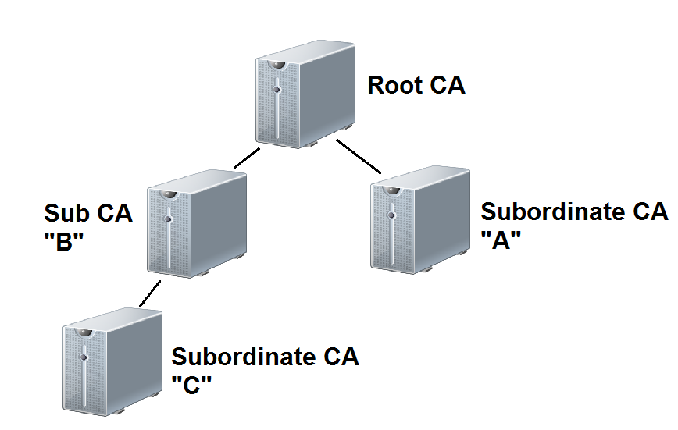
PKI hierarchy

Slide 207
CA concerns
Every CA should have a Certification Practice Statement which outlines
How the RA verifies identities
How the Certificates are transferred
How keys are secured
What data is in a Digital Certificate
How revocations are handled… etc
Before using a 3rd party CA, you should understand and be comfortable with CPS and the security controls they use.*

Slide 208
Multiple Certificates
Some PKIs use multiple certificates, and as such multiple public/private key pairs.
One for digitally signing data
One for encrypting data
Why would we want to have two different keys?

Slide 209
Certificate Renewals
Certificates have a lifetime after which they expire. Why?
When a certificate expires you have to renew it. You don’t have to go through the RA again. You just have to be able to sign a message with your old private key.
When renewing you can use the old public/private key pair or generate a new key pair. What is the advantage of generating a new pair?

Slide 210
Certificate Revocation
We have a wonderful system of distributing and verifying Digital Identities (certificates). But we may need to revoke a users digital Identity?
Why?
Hint – think Human Resources
Hint – think hacking

Slide 211
Certificate Revocation
The CA publishes a Certificate Revocation List.
Certificate serial number that have been revoked
Reason for revocation
Date of revocation
The CRL is digitally signed by the CA*

Slide 212
Certificate Revocation (736)
Client software must check the CRL before trusting a digital certificate
Once a certificate is revoked, it cannot be un-revoked
A certificate could be suspended. This also goes on the CRL, however a special “reason” of suspended is used.
Suspended certificates may be un-suspended

Slide 213
OCSP (737)
Online Certificate Status Protocol – a client server model, where a client program actually queries a server to see if someone’s certificate is valid. This way the client does not need to know how to find the CRL for the given certificate Authority and doesn’t have to actually search through the CRLS.
Be aware of this term for the exam.

Slide 214
Key Recovery
When an organization uses encryption to protect data, it must also backup the keys.
This is called key archival
Only backup the encryption private key in a multi-certificate system
Need to ensure the safety of these backups
Use dual controls (m of n) concept to protect keys

Slide 215
Key Recovery
No need to backup public keys.
The process of retrieving keys is called key recovery
Key recovery should be highly controlled and audited

Slide 216
Key Escrow
key archival using a 3rd party

Slide 217
PKI concerns
What happens if the CA is compromised?
What happens if the Certificate repository is compromised?
What happens if someone steals my digital certificate?
A digital certificate contains an entities public key. Why?
Does it make sense to put a private key in a digital certificate?

Slide 218
PKI concerns
Remember PKI requires public keys (in the certificate) and private keys (kept private to a user). Often private keys are kept in storage on a hard drive, or on a removable drive (USB key)
What are some concerns and countermeasures dealing with private key storage?

Slide 219
PKI concerns
Remember PKI requires public keys (in the certificate) and private keys (kept private to a user). Often private keys are kept in storage on a hard drive, or on a removable drive (USB key)
What are some concerns and countermeasures dealing with private key storage?

Slide 220
Extended Validation Digital Certificates
Digital certificates issued after the issuing authority performs a more extensive background check on the entities identity prior to issuing.
Needed if the entity wants to provide additional assurance to the end user of their identity. Such as
Banks
Online stores

Slide 221
Email Security

Slide 222
Internet
The Internet has been around for a LONG time... For most of it’s life nobody cared about the Internet except for government, researchers and geeks like me.
The Internet was never intended for security. IT was indented as a resilient network for communications. Nobody ever though it would be used for what it’s used for today

Slide 223
Email (745)
Email has been around for a LONG time as well, as such the is NO security in the SMTP protocol. It was assumed that everyone who was using Email would just play nice. As such SMTP provides.
No Authentication
No Encryption
Email wasn’t even intended to send anything advanced (like images, sounds, word documents). It was just intended to send text.

Slide 224
Email Security
Email is counted on by organization for a means of communications, some would say it’s even mission critical. That leaves two problems:
Forged email
Compromise of confidential information sent over email

Slide 225
Forged Email
Forging of email is TRIVIAL in most cases.
What are some concerns with forged emails?

Slide 226
Forged Email
Can anyone think of any technologies we already discussed that can help with the email forgery problem?

Slide 227
Signing Email
If we use digital certificates we can sign our email to solve the authentication problem.

Slide 228
Email Encryption
The other problem with email is that sensitive information might be sent over email.
SSNs
Credit card
Private data
Encrypting email would solve this problem.

Slide 229
Email Security (745)
There are a few technologies we can use to secure email both by providing non-repudiation services, and encryption services
S/MIME
PEM
MSP
PGP

Slide 230
PEM (746)
Privacy Enhanced Mail – Internet standard to provide secure email. Provides authentication, integrity, encryption and key management.
RSA for authentication and key management
X.509 certificates
Never widely deployed

Slide 231
S/MIME (745)
MIME was the original extension to email that allowed us to attach files in email, such as images and sounds and word documents etc.
SMIME is an extension to MIME that allows for
Integrity, privacy and sender authentication
Uses x.509 digital certificates
Uses RC2 or Triple DES

Slide 232
Message Security Protocol (747)
Military’s version of PEM

Slide 233
PGP (747)
Pretty Good Privacy - Can provide Integrity, Security and Non-Repudiation
Certificates for identification and authentication
Signed messages for non-repudiation
Used to use a web of trust model, but now can tie into an organizations PKI.
Originally used IDEA heavily but can use many encryption algorithms.
Originally used MD5 hash for integrity newer versions use SHA series and other hash algorithms.

Slide 234
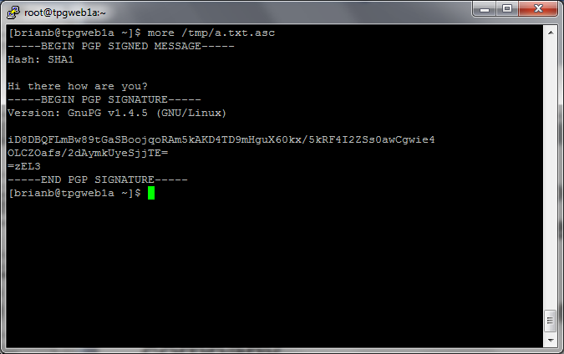
PGP signed message example

Slide 235
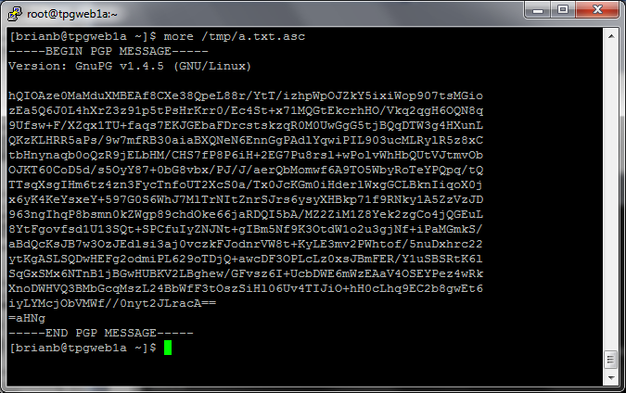
PGP encrypted and signed

Slide 236
Other Email Terms
Content based filtering – Some companies try to ensure that sensitive information is not sent over email. They may scan outgoing email for text that looks like SSNs or credit card numbers etc.
SPAM – Unsolicited email

Slide 237
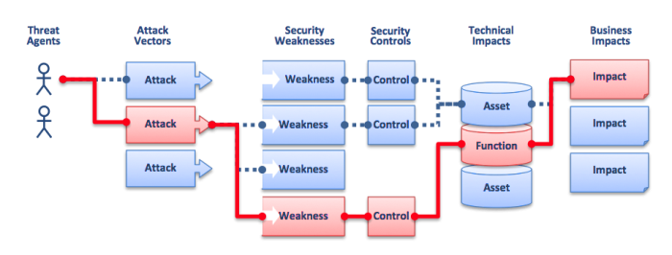
OWASP Risk Rating Methodology
Source: https://www.owasp.org/index.php/Top_10_2010-Main Last visited 9/21/2014.

Slide 238
From Authorities to Audits
Examples
Technical, physical, and administrative requirements that must be in place to ensure compliance with the authorities
Statements of how a company will implement and enforce requirements
Implementation of the technical, physical, and administrative requirements found in the policy statements
Verification of appropriately implemented controls to comply with requirements
PCI
HIPAA
NERC
Authorities
Requirements
Policies
Controls
Audits
PCI-DSS Example
Authority: PCI-DSS is the authority document created by the PCI-SSC.
Requirement: (10.6) Review logs for all system components at least daily.
Policy: Monitoring Policy – States logs will be reviewed at least daily.
Control: Tool XYZ provides real-time monitoring for all system components.
Audit: Auditor verifies Tool XYZ is appropriately monitoring and alerting to actionable events. Audit results and evidence are stored as part of the audit.

Slide 239
Effectively Managed IT Controls
Technology can affect every part of the business.
At its best, technology is a competitive advantage.
At its worst, technology is your competitor’s advantage.
Product
Market Relationships
IT Controls:
Detective, protective and reactive measures in place to protect the confidentiality, integrity, and availability of business information and ensure appropriate management of the IT function to meet business objectives.
Inbound Logistics
Operations
Outbound Logistics
Marketing
and Sales
Service
Firm Infrastructure
HR Management
Margin
Procurement
Technology Development
Notes:
Compliance Control: A process, effected by management and other personnel, designed to provide reasonable assurance that transactions are executed in accordance with 1) laws governing the use of budget authority and other laws and regulations that could have a direct and material effect on the financial statements or required supplementary stewardship information and 2) any other laws, regulations, and government wide policies identified in OMB audit guidance. [GAO/PCIE Financial Audit Manual]
Source: http://www.unifiedcompliance.com/it_compliance/language_compliance/definitions/c.html

Slide 240
Chris Davis
UTD Email: cmd140430@utdallas.edu
Google Voice: 214-771-8122
Course Materials
https://elearning.utdallas.edu

Slide 241
Additional Materials

